Slide 1

Cost-Effective App Data Distribution in Edge Computing
RAVI SHANKAR – 170101053
UNDER THE GUIDANCE OF DR. ARYABARTTA SAHU

Slide 2
Outline
Introduction and Industry Examples.
Problem Definition.
Solution Strategies.
Other Approaches in Comparison.
Experimental Results.
Implementations.
Conclusion.
Plan for Phase II.
References.

Slide 3
Introduction
Cloud computing is the practice of using a network of remote servers hosted on the internet to store, manage, and process data, rather than a local server or a personal computer.
Latency influenced by the number of router hops, packet delays introduced by virtualization in the network, or the server placement within a data center, has always been a key issue for cloud migration.
Other conventional network paradigms cannot handle the huge increase in the network latency and congestion caused by the resources at the edge of the cloud.
This is where edge computing kicks in, which is essentially the process of decentralizing the computer services with the help of edge servers deployed at the base stations.
From an app vendor’s perspective, caching data on edge servers can considerably reduce both the latency for their users to fetch data and the volume of their app data transmitted between the cloud and its users. Thus, reducing the transmission costs.

Slide 4
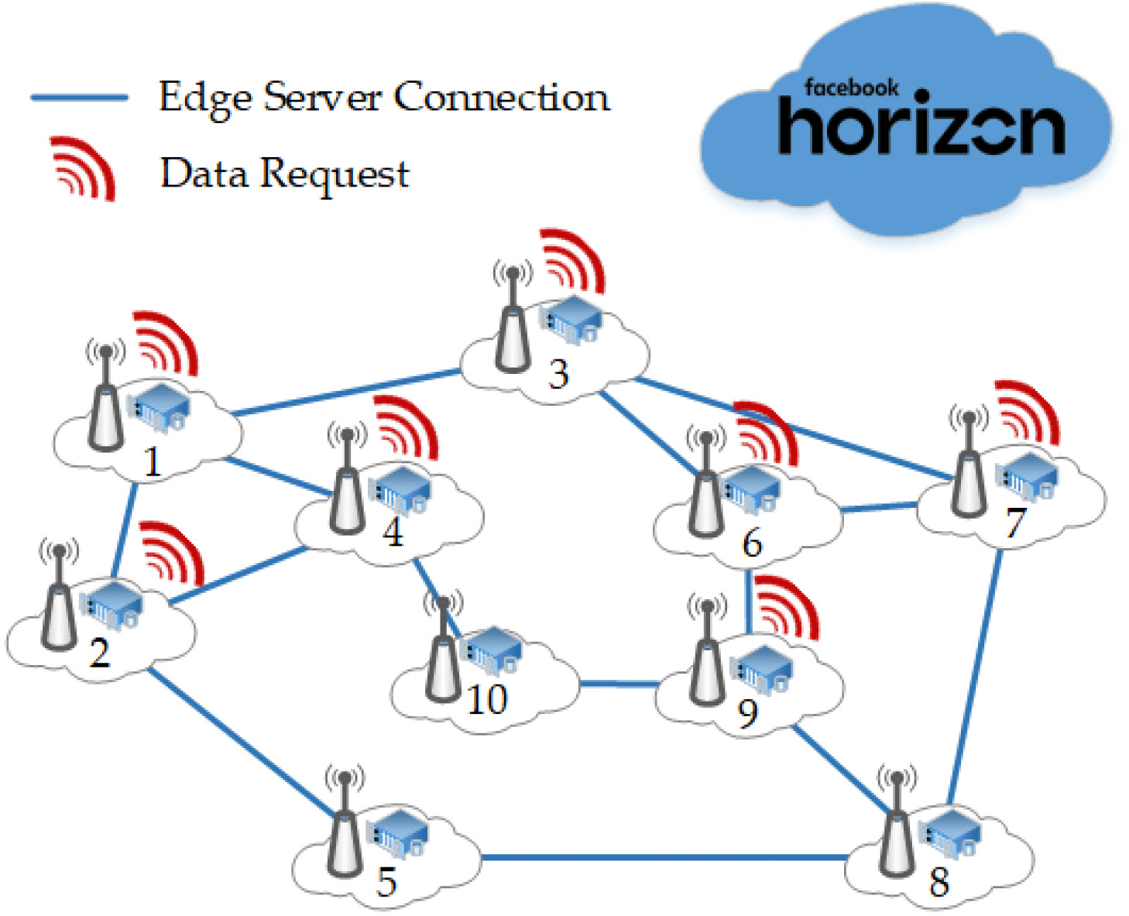
An Industry Example
Facebook Horizon can benefit greatly from distributing most popular VR videos and VR games onto the edge servers.
VR applications are very latency sensitive, thus caching these data onto edge servers will increase VR performance, experience and sensitivity.
Cost-Ineffective app data distribution can thereby cost Facebook Horizon significantly more.

Slide 5
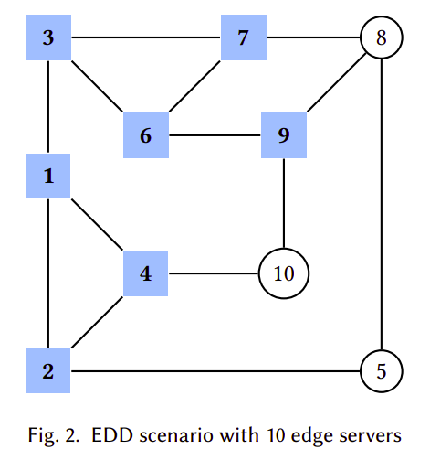
Problem Definition
We take 𝑛 edge servers in a particular area and model it as a graph 𝐺.
For each edge server 𝑣, graph 𝐺 has a node 𝑣.
For each of the linked edge servers (𝑢,𝑣), graph 𝐺 has a corresponding edge 𝑒_{(u, v)}.
Thus, we use 𝐺(𝑉,𝐸) to represent the graph, where 𝑉 is the set of nodes or edge servers in the graph and 𝐸 are the set of edges in the graph.
Let 𝑅 denote the set of destination edge servers in graph 𝐺.

Slide 6
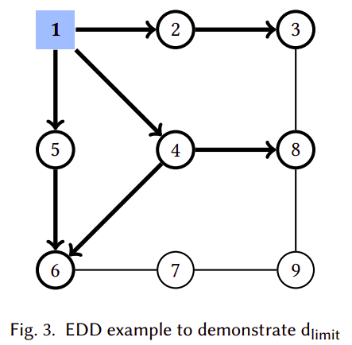
Problem Definition
Let d_{limit} be the vendors' latency constraint.
Two Possible Scenario – C2E and E2E.
Thus, we need to define a relationship between these two transmissions, so that they can be incorporated easily into the generic optimization objective model. We define a ratio 𝛾 to specify the difference between the C2E and E2E transmission costs. For e.g., 𝛾 = 20, means the 𝐶𝑜𝑠𝑡_{C2E} is 20 times more than 𝐶𝑜𝑠𝑡_{E2E}.

Slide 7
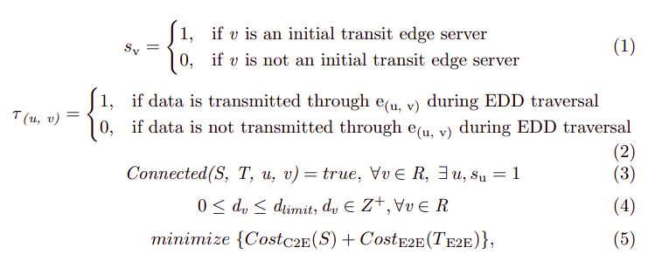

Slide 8
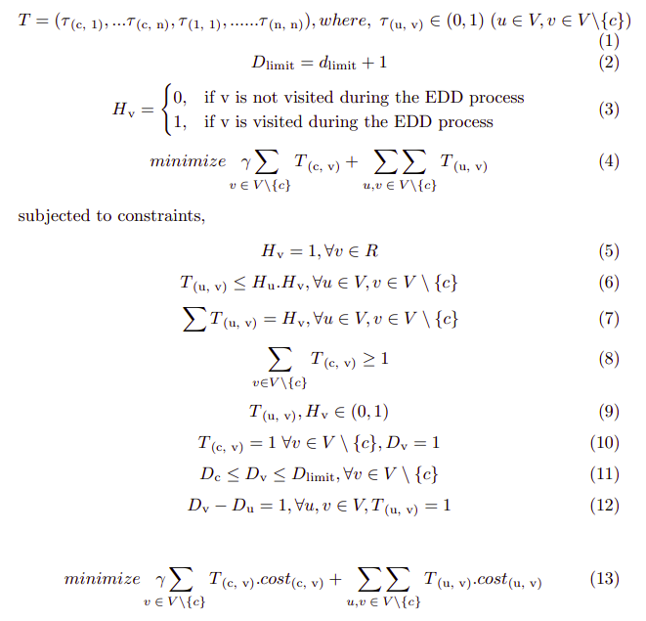
Solution Strategy – I
Edge Data Distribution as an Integer Programming Problem.

Slide 9
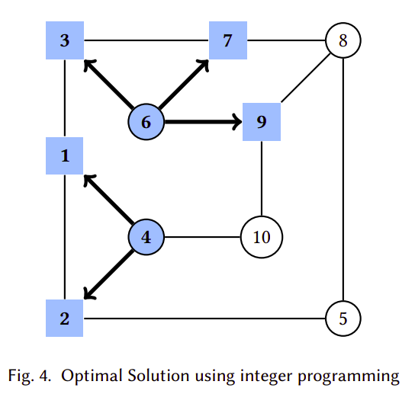
Optimal Solution Using Integer Programming.
Edges C2E :– e_{(c, 4)} and e_{(c, 6)}.
Edges E2E :– e_{(6, 3)}, e_{(6, 7)}, e_{(6, 9)}, e_{(4, 1)} and e_{(4, 2)}.
d_{limit} = 1 for the given example.
Total Cost = 2𝛾 + 5 times of the 1-Hop E2E transmission cost.

Slide 10
Solution Strategy – II
Edge Data Distribution as a Network Steiner Tree Approximation.
First of all, we calculate a network steiner tree approximation with destination edge servers 𝑅, as the set of distinguished vertices, in the given graph 𝐺.
Then, we present a heuristic algorithm which estimates a rooted minimum steiner tree, by adding cloud 𝑐 to the graph, and then slicing and fine-tuning the rooted steiner tree with the vendor’s latency constraint of 𝐷_{limit}.

Slide 11
Here, given a graph 𝐺, we first calculate the metric closure of the graph, denoted by 𝐺', which is a complete graph of 𝐺, having edge lengths equal to the shortest distance between the vertices in 𝐺.
𝐺'_{R} denotes the subgraph of 𝐺 induced by a vertex subset 𝑅 ⊆ 𝑉 , i.e., the subgraph on destination edge servers.
We denote the minimum spanning tree (MST) of any graph 𝐺 as 𝑚𝑠𝑡(𝐺).
Given a metrically closed graph 𝐺, we may contract an edge 𝑒, i.e., reduce its length to 0, we represent such a resulting graph as 𝐺[𝑒]. For any triple set of vertices, 𝑧 = (𝑢, 𝑣, 𝑤) we represent 𝐺[𝑧] as a graph resulting from contraction of two edges i.e., 𝑒(u, v) and 𝑒(v, w).
𝑇𝑟𝑖𝑝𝑙𝑒𝑠 denotes the set of all combination of 3 destination edge servers.
𝑣(𝑧) denotes the centroid of a particular triple, i.e., the vertices other than the destination edge servers whose sum of distance from a triple is minimum.
𝑑(𝑒) denotes the length of the edge 𝑒.

Slide 12
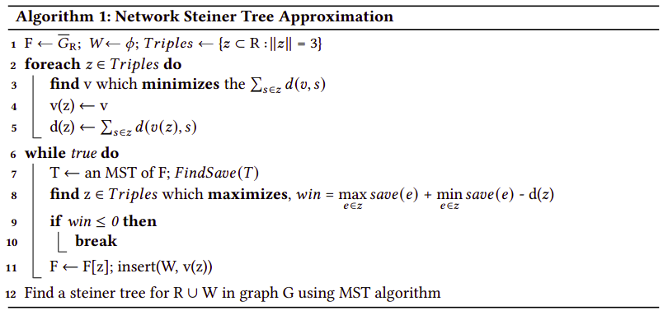
Network Steiner Tree Approximation
In a few words, the algorithm presented finds, as-long-as possible, the best reduction of the cost of MST of F, which initially coincides with G_{R}, by adding to an MST of F three G-edges with a common end and removing the longest edges from each resulting cycle. After the triple contraction we get the next F.
The implementation time complexity is O(|V||E| + IRI⁴).

Slide 13
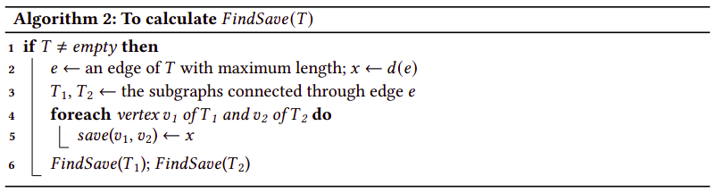
FindSave(T) is the procedure that calculates the save matrix for the edge servers in T.
Here, we calculate a 𝑠𝑎𝑣𝑒 matrix for edges in the graph 𝐹 , to estimate the maximum win for a given triple, where 𝑠𝑎𝑣𝑒 (𝑣1, 𝑣2) is the minimum value, such that both ends 𝑣1 and 𝑣2 are in the same component of 𝐹 , given by the equation below. The implementation time complexity of this algorithm is O(|R|²).
𝑠𝑎𝑣𝑒 (𝑣1, 𝑣2) = 𝑚𝑠𝑡(𝐹 ) − 𝑚𝑠𝑡(𝐹 [𝑒(𝑣1, 𝑣2)]), ∀ 𝑣1, 𝑣2 ∈ 𝐹

Slide 14
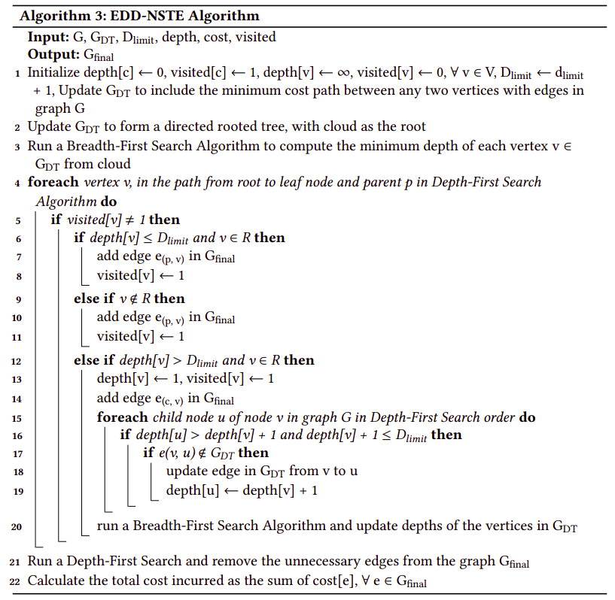
Procedure 3 – For the fine tuning, pruning and slicing of the graph to satisfy the vendors' latency constraint of D_{limit}.
Time Complexity = O(|V| + |E|)

Slide 15
Simulation Settings and Approaches for comparison of the result
Greedy Connectivity (GC)
Random
EDD Integer Programming
EDD – Approximation (EDD-A)

Slide 16
Dataset Used and Experiment Data
The experiments were conducted on a widely used EUA Dataset. This dataset contains the geographical locations of 1,464 real-world base stations in Melbourne, Australia.
In the experiments, 𝛾 = 20 is taken.
All experimental were conducted on an Ubuntu 18.04.5 LTS machine equipped with Intel Core i5-7200U processor (4 CPU’s, 2.50GHz) and 16GB RAM. The integer programming simulation was done on Google Collab (Python 3 Google Computer Engine Backend, 12.72GB RAM).

Slide 17
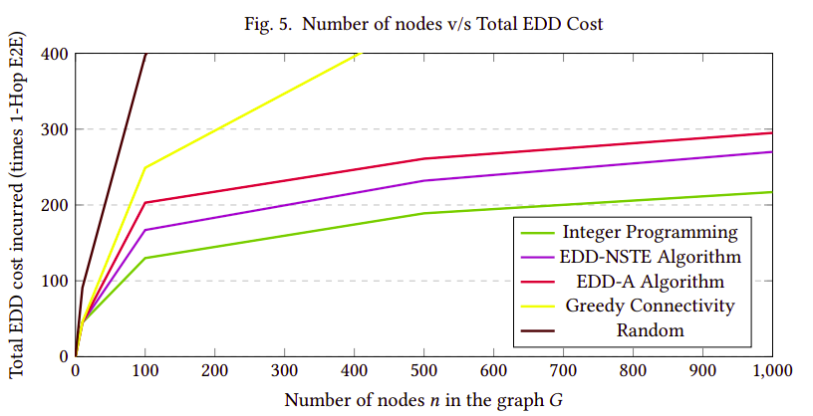
Experiment Results

Slide 18
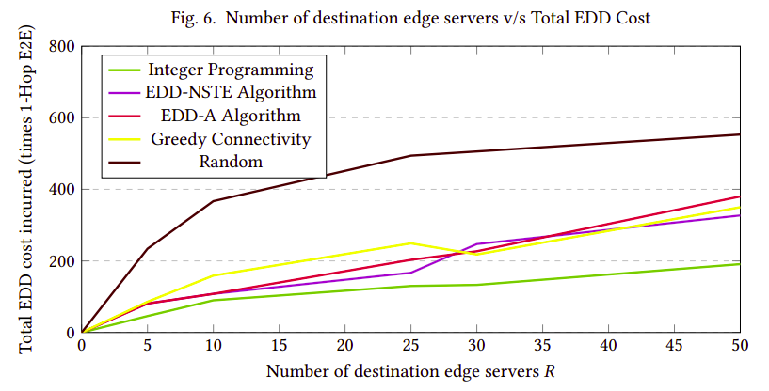
Experiment Results

Slide 19
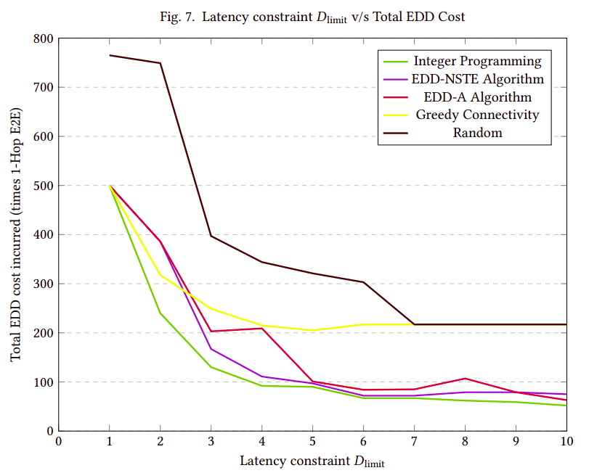
Experiment Results

Slide 20
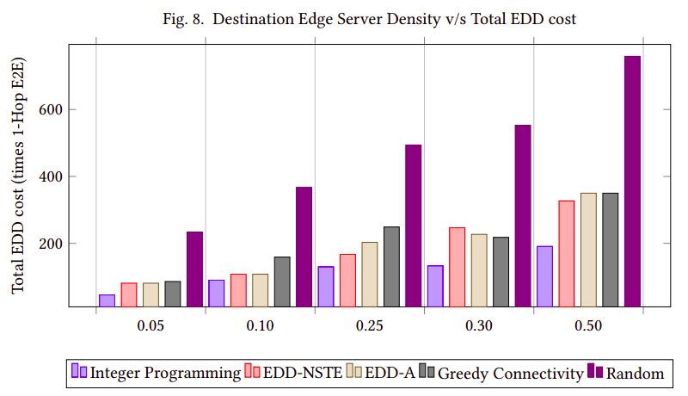
Experiment Results

Slide 21
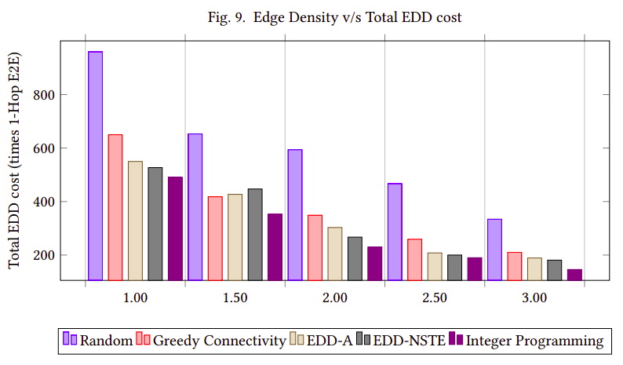
Experiment Results

Slide 22
Implementation
All above-mentioned solutions and approaches in comparison have been implemented.
Integer Programming Solution – Implemented using Google Collab Python-PuLP from scratch.
Greedy, Random, EDD-A and EDD-NSTE – Implemented completely in C++ from scratch.
Link to the repository – GitHub

Slide 23
Conclusion
The EDD-NSTE algorithm suggested in this report performs considerably better than the other simulations and approaches implemented for the edge data distribution problem.
The algorithm also performs significantly better than the last best EDD-A algorithm suggested. The EDD-A algorithm is an 𝑂(𝑘) approximation algorithm4 and the EDD-NSTE algorithm is an 𝑂(𝑘′) approximation algorithm where 𝑘 ′ < 𝑘 and thus, the performance of EDD-NSTE is better than EDD-A, which coincides with the experimental evaluations done so far.
EDD-NSTE algorithm produced better solutions than EDD-A or other simulations in more than 86.67% of the test cases, ranging from very dense graphs to sparse graphs or trees.

Slide 24
Plan for Phase-II of BTP work
The lower bound to approximate Steiner Tree in general graphs is smaller than 1.01 theoretically. The current best algorithm has an approximation ratio of (1.39+epsilon). Thus, implementing a better way of estimating the Steiner Tree can help improve the approximation ratio and so, we would work on incorporating these methods in our edge data distribution solution.
We would also try and implement a heuristic algorithm completely independent from Steiner Tree approximation that can estimate better solutions.
We would also try and attach a definitive proof for the approximation ratio of the EDD-NSTE algorithm.
More thorough testing of these above-mentioned algorithms will also be done to test their efficiency with the previous methods.
Finally, we will try and produce a series of solutions that can then be used for the edge data distribution problem depending on the various use-cases in the industry.

Slide 25
References
[1] Anil Maheshwari Ahmad Biniaz and Michiel Smid. 2015. On the hardness of full Steiner tree problems. Journal of Discrete Algorithms 34, 7 (Aug. 2015), 118–127.
[2] Stephan Beyer and Markus Chimani. 2014. Steiner Tree 1.39-Approximation in Practice. Mathematical and Engineering Methods in Computer Science. MEMICS, Springer 8934, 7 (Feb. 2014), 60–72.
[3] Till Nierhoff Clemens Gröpl, Stefan Hougardy and Hans Jürgen Prömel. 2001. Approximation Algorithms for the Steiner Tree Problems in Graphs. Springer Verlag Berlin Heidelberg 46, 5 (May 2001), 235–279.
[4] Till Nierhoff Clemens Gröpl, Stefan Hougardy and Hans Jürgen Prömel. 2001. Lower Bounds for Approximation Algorithms for the Steiner Tree Problem. Springer Verlag Berlin Heidelberg 13, 7 (Aug. 2001), 217–228.
[5] Victor Eijkhout, Edmond Chow, and Robert van de Geijn. 2014. Introduction to High Performance Scientific Computing. Creative Commons Attribution, Texas, Austin.
[6] Aryabartta Sahu. 2020. High Performance Computing. https://www.iitg.ac.in/asahu/cs528/
[7] Amit Samanta and Jianhua Tang. 2020. Dyme: Dynamic Microservice Scheduling in Edge Computing Enabled IoT. IEEE Internet of Things 7, 7 (Oct. 2020), 6164–6174.
[8] HXiaoyu Xia, Feifei Chen, Qiang He, John C. Grundy, Mohamed Abdelrazek, and Hai Jin. 2021. Cost-Effective App Data Distribution in Edge Computing. IEEE Transactions on Parallel and Distributed Systems 32, 1 (Nov. 2021), 31–43.
[9] Yang Yang, Kunlun Wang, Guowei Zhang, Xu Chen, Xiliang Luo, and Ming-Tuo Zhou. 2018. MEETS: Maximal Energy Efficient Task Scheduling in Homogeneous Fog Networks. IEEE Internet of Things 5, 5 (Nov. 2018), 4076–4087.
[10] Haitao Yuan, Jing Bi, and MengChu Zhou. 2020. Geography-Aware Task Scheduling for Profit Maximization in Distributed Green Data Centers. IEEE Transactions on Cloud Computing 31, 15 (Jan. 2020), 1–11.
[11] Alexander Z Zelikovsky. 1993. An 11/6-approximation algorithm for the network steiner problem. Algorithmica 9, 5 (Dec. 1993), 463–470.
[12] Alexander Z Zelikovsky. 1993. A faster approximation algorithm for the Steiner tree problem in graphs. Inform. Process. Lett. 46, 5 (May 1993), 79–83.
[13] Dongfang Zhao, Mohamed Mohamed, and Heiko Ludwig. 2018. Locality-Aware Scheduling for Containers in Cloud Computing. IEEE Transactions on Cloud Computing 8, 2 (Dec. 2018), 635–646.

Slide 26

Thank You

